Slide 1
Switch over hybrid vehicle
-With Future Concept
By : Tech Boyzz

Slide 2

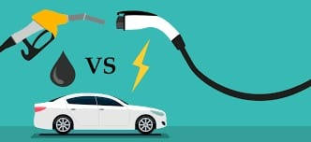
PROBLEM STATEMENT
If it is a Electric Car Range depend on its battery And Also The Charging stations are fewer .
A Hybrid Vehicle is one that uses two or more distinct types of powers . The initial Cost of Hybrid Car is More Expensive and it is not easy to find a mechanic with required experience

Slide 3
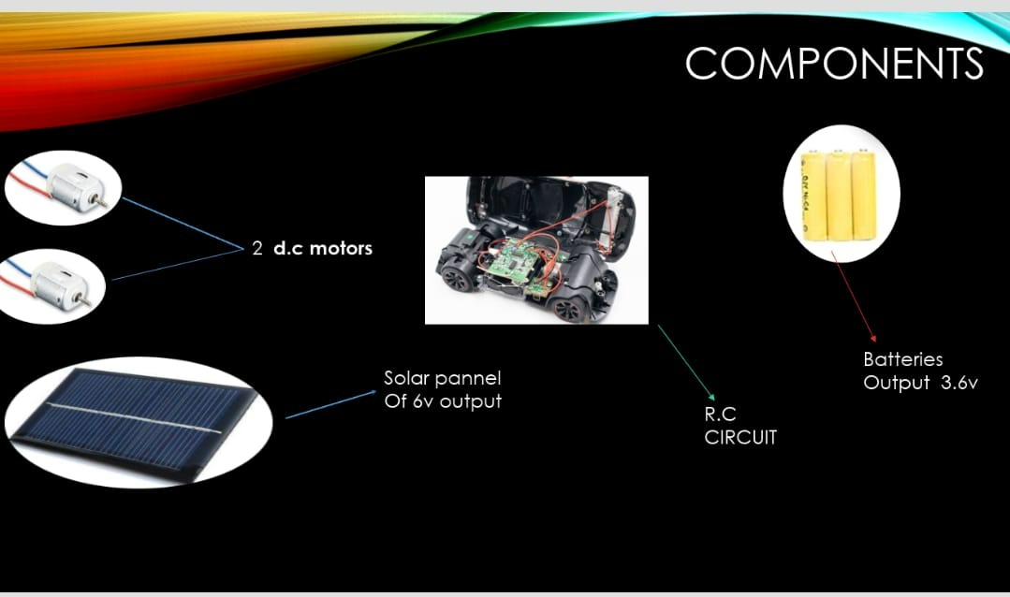
Now a days the people are struggling to buy the electric cars due to the suffering of charging
Vehicle
So By the previous theory we enable a model
For avoid this problem
1.What is the model?
This model is made by a car have a rechargeble battery and a solar pannel attach with it
2.What are the benefits of the model?
These are eco friendly
No Effect On Battery Due To
Independent Cells
Sufficient Battery Management System(BMS)
No air pollution

Slide 4

Working Video

Slide 5
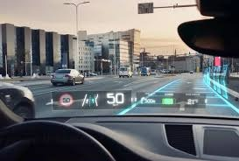
Ar – navigator
In Hybrid vehicle
Augumented Reality for drivers :
Instead of glancing at their phone or around the car for important information, the driver can have a full view of everything they need without even turning their head. This has the potential to improve safety and innovation across an entire industry.

Slide 6
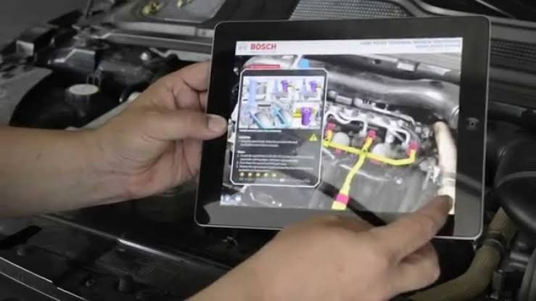
Mini Service
In Hybrid Vehilce
The Proper Guidelines given to the User By the Website Built in the Car For Solving the Minor Issues
It is Responsible For the Users who Does Not Have Vehicle Experience

Slide 7


OUR MAIN THEME OF THE PROJECT IS
To avoid noise and air pollution
Develop a new era for technology
To become eco friendly
Reduce the fear of charging
KEEP THE AIR CLEAR

